Slide 1
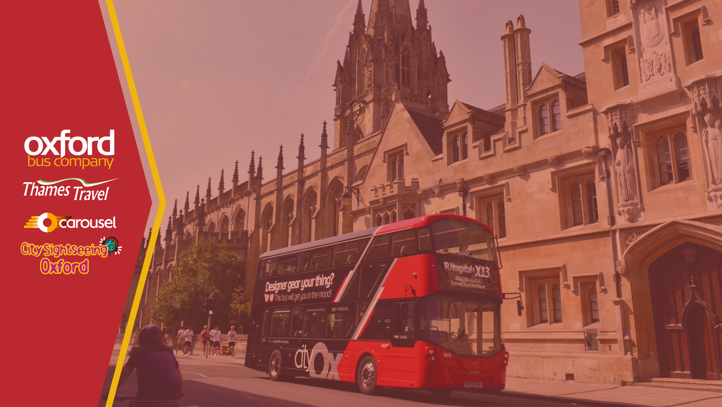
Stakeholder Update
June 2021

Slide 2

Welcome Back!
Wow, a lot has happened since our last Stakeholder newsletter last September!
When we last wrote to you, we were looking forward to supporting our community’s recovery from the COVID-19 pandemic.
After what has been a hard winter for us all, this time it feels like there really is light at the end of the tunnel, and with each day that passes we are delighted to be welcoming more and more of our customers back to our services.
This stakeholder update will bring you up to date with everything we’ve been doing during the pandemic to keep improving our services including some changes we’ve made in response to our recent Stakeholder Survey - a big thank you to all who took the time to fill it in.
We’ll take you through initiatives across each of our five core values, so read on and enjoy.

Slide 3

Hello from Phil Southall!

Slide 4
Customer Focused: Cleanliness of our Buses
During the pandemic, our customers have told us that cleanliness of vehicles is their top priority.
In this video, our Service Delivery Director, Paul Hennigan, explains some of the things we’ve done to make sure we achieve very high standards of cleanliness for every vehicle, every day.

Slide 5
Customer Focused: Our Cleaning Contractor
To support the changes we wanted to make to our cleaning processes during the pandemic, we brought in a new cleaning contractor, Nationwide Cleaning & Support Services. They’ve been specializing in bus cleaning for the past 20 years. In this video, Nationwide Operations Manager, Steve McCaffrey, explains how they have also had to adapt what they do in response to the pandemic.

Slide 6
Customer Focused: On-board Safety Features
Since the beginning of the pandemic, we’ve been enhancing our on-board safety features on all our vehicles, both for our colleagues and for our customers. Watch the below video to find out what we're doing to keep our customers and our colleagues safe.

Slide 7
Customer Focused: Ticketing Improvements
We recently introduced Freeflow tap on, tap off contactless ticketing and smart key card top-ups on our buses to make travelling easier and safer for our customers. Find out more by watching the below video.

Slide 8
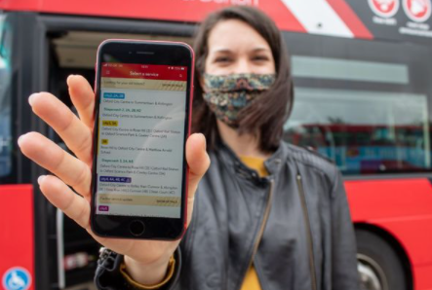
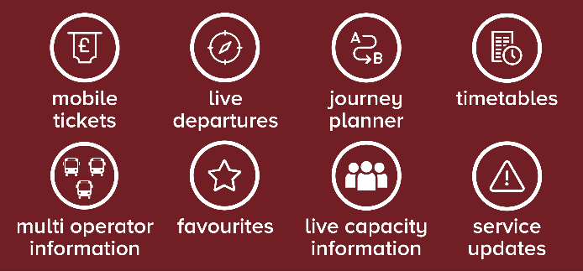
Continued Success: New Mobile App
On Tuesday 25th May 2021, we successfully launched the new and improved mobile apps for Oxford Bus Company/Thames Travel and Carousel, which come with an entire host of new features, as well as improved versions of the ones enjoyed by our existing app customers. For the first time, the app now includes live tracking of Stagecoach, Arriva, First and Red Rose buses as well as our own.
The features of the new apps include:

Slide 9
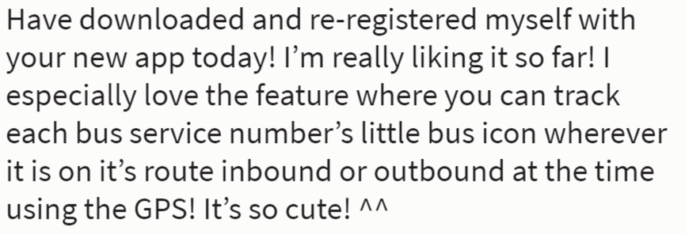
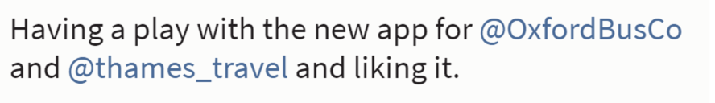
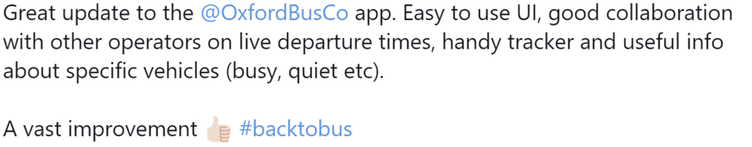
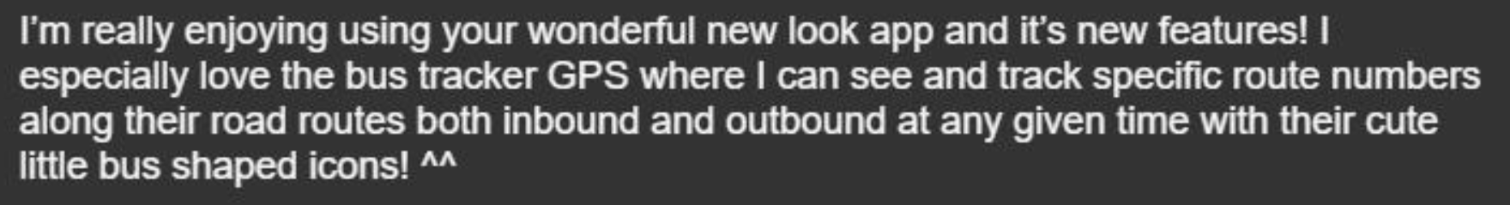
Continued Success: New Mobile App Feedback
We have already received lots of positive feedback on the new app from customers:

Slide 10


Continued Success: Double-Up Scheme
Oxford Bus Company and Thames Travel together with Stagecoach recently launched a new business-to-business discount scheme allowing local businesses to offer their employees extra discount on bus tickets to support their return to the workplace.
We are offering to match all extra discount given by employers, so if an employer wishes to fund an extra 10%, we will also fund extra 10%, giving 20% discount to the employee. The scheme is running until the end of August 2021 and annual tickets can be purchased as part of the scheme.
The scheme received great engagement so far, with large employers already signed up.
If you would like to enquire about how the scheme can help your business, please contact keylink@oxfordbus.co.uk.

Slide 11
Continued Success: Service Improvements
During the pandemic, we’ve not been resting on our laurels. We’ve made lots of really useful changes to our service network that are going to continue for when everyone comes back to bus.
Watch the below video to find out more about our service improvements.

Slide 12
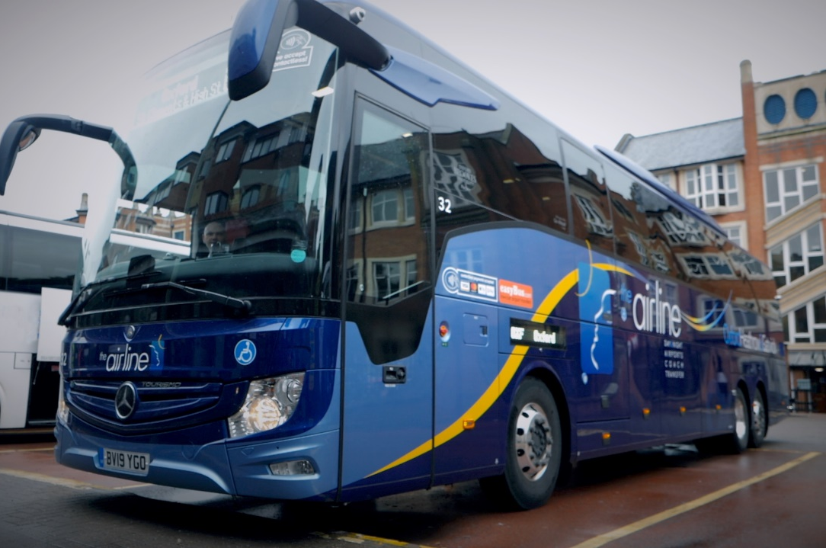
Continued Success: The Airline
From 17th May, following the announcement of the UK’s travel green list and anticipated growth in air travel, we increased the frequency of the airline to Heathrow Airport.
This was another positive development and our first step in supporting people wishing to take international or domestic flights. Our airline service to Heathrow has been operating right through the pandemic and is a key part of connectivity to Heathrow Airport and we look forward to welcoming back more of our customers.
During the pandemic, we introduced a new stop on the airline at High Wycombe Coachway, enabling customers living in the High Wycombe area to connect with the airline on Carousel services and travel to Oxford or Heathrow Airport. This is a new business opportunity that’s worth exploring when air travel fully reopens.
We are in continued talks with our airport partners and are confident of re-introducing the Gatwick service as the number of countries on the green list grows.
We have also launched an improved booking system, enable customers to reserve their seats with ease.

Slide 13
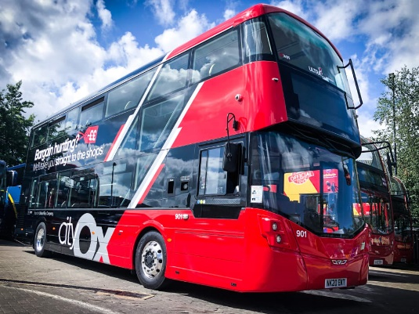
Continued Success: Service X2/X3/13 Improvements
In January 2021, we introduced positive changes to our X2, X3 and 13 services.
The previous cityX13 service, providing the through service between Abingdon, Oxford City Centre and JR Hospital was replaced by higher frequency coordinated cityX3/13 and Thames Travel X2 services.
Between Oxford City Centre and Abingdon, cityX3 and Thames Travel X2 services coordinate to provide buses up to every 10 minutes on Monday to Saturday daytimes and every 15 minutes during the evenings and on Sundays. The X2 extends to Oxford Rail Station, restoring the link between Abingdon, Abingdon Road and Oxford Rail Station which had been lost for several years as a result of the disruption caused by the “Access to Headington” roadworks. The X2 service operates every 20 minutes on Monday to Saturday daytimes and every 30 minutes during the evenings and on Sundays.
Meanwhile, the re-routed and renumbered cityX3 service is now extended beyond Oxford City Centre, to JR Hospital, replacing the cityX13 and maintaining the direct service between Abingdon and JR Hospital throughout the day, seven days a week. Between Oxford City Centre and JR Hospital, the cityX3 and city13 services coordinate to provide buses every 10 minutes on Monday to Saturday daytimes.
With financial support from Oxfordshire County Council, the revised cityX3 service is also extended to the new Barton Park development across the Northern By-pass. The subsidised service provides much of Barton and all of the new development with a faster route to JR Hospital and operates every 20 minutes on Monday to Saturday daytimes and a 30-minute frequency during the evenings and on Sundays.
On top of all this, we also introduced brand new Wrightbus Streetdeck vehicles 901-903 to our city fleet, typically operating on the cityX3/13 routes, along with a striking new livery!

Slide 14
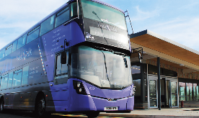
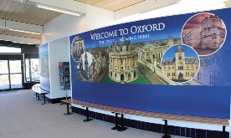
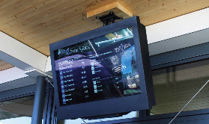
Continued Success:
Seacourt Park&Ride new facilities
In April 2021, a new building at Seacourt Park&Ride was opened! The infrastructure includes toilets, an enclosed waiting area and digital information screens which provide real-time journey information.
These brand-new customer-friendly facilities are helping us welcome people back onto our bus services.
The car park capacity has also been increased by 595 spaces, taking the number of spaces for vehicles to more than 1,300.
The improvements were made possible thanks to an investment by Oxford City Council, and we assisted with through installing additional information boards, leaflet racks and by working with suppliers to ensure the real time information screen worked from day one!

Slide 15
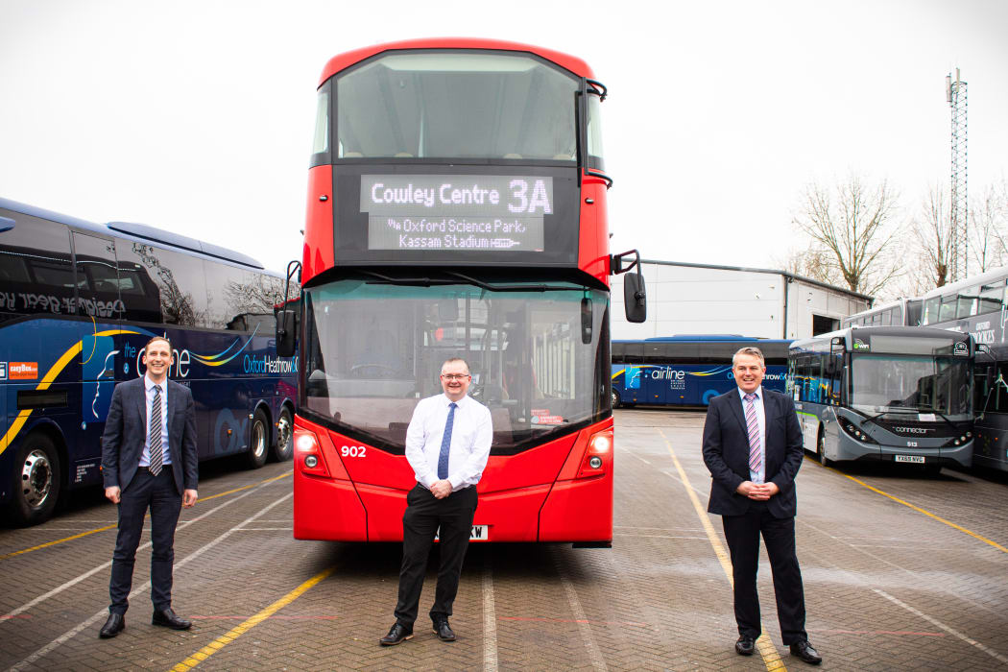
Continued Success: Vaccination Centre Buses
In February 2021, together with Stagecoach, we amended our city3A services to provide crucial daily links to the new mass COVID-19 vaccination centre at the Kassam Stadium in Oxford.
With the Kassam Stadium designated as a key vaccination hub in Oxfordshire and as many as 8,000 to 10,000 vaccinations expected to take place there weekly, we reacted quickly to ensure improved connectivity to the centre.
The revised timetable provides a direct half-hourly service to the vaccination centre from both Oxford city and Cowley, seven days a week.
It is important as many people are vaccinated as possible, as quickly as possible, and we are proud to be supporting this public health programme.

Slide 16
Continued Success: Milton Park Partnership
As part of our partnership with Milton Park, we have recently introduced substantial improvements to our bus connectivity, offering new direct connections to Headington, Wantage and Grove, and improved service to Oxford, Didcot Parkway and Abingdon. But our support doesn’t finish there.
Watch the video below to see how we support our partners.

Slide 17
Continued Success: Milton Park Partnership
Here are some examples of the promotional videos we produced for our partners at Milton Park.
Bus connections from Oxford and further afield:
Bus connections from Didcot:

Slide 18
Continued Success: Bicester Village Partnership
During the pandemic, we started an important new contract with Bicester Village and we are working closely with them to provide exceptional service to their guests. Find out more by watching the below video.

Slide 19
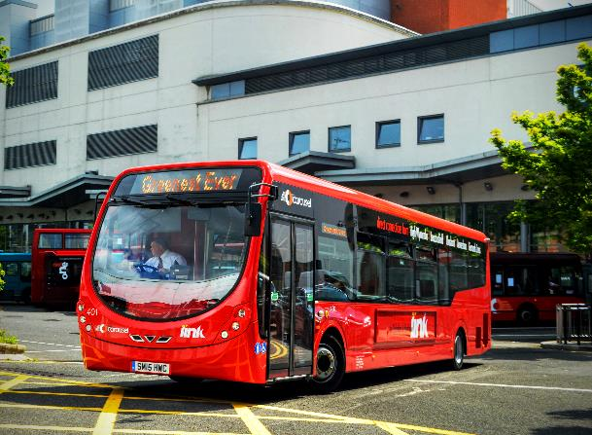
Continued Success: Expanded Fleet of Clean Technology Vehicles at Carousel Buses
At Carousel Buses, we recently increased the number of ultra-low emission buses in our fleet, thanks to a significant investment in green technology.
12 buses in our fleet have been upgraded to the latest Euro VI emission standard, through fitment of exhaust after-treatment technology which reduces emissions of harmful nitrous oxides by as much as 90%.
The £200,000 investment in retrofitting the vehicles will positively contribute to improving air quality across Buckinghamshire, and parts of Hertfordshire and Greater London. The upgraded vehicles went into service in March on the Chiltern Hundreds services operating between High Wycombe, Beaconsfield, Gerrards Cross and Uxbridge. This takes the number of Euro VI buses in the Carousel fleet to 28, more than 50% of the total fleet.
Each bus has free Wi-Fi, luggage space, and contactless payment technology.

Slide 20

Continued Success: City Sightseeing Oxford
We restarted our open top bus tours on 12th April and Carfax Tower and Oxford walking tours on 17th May in line with the easing of COVID-19 restrictions.
We know that what we do is a key ingredient to Oxford’s visitor offerings, so we were keen to start back as soon as we could.
VOX City Walks Oxford (in partnership with City Sightseeing Oxford) are coming soon! We are planning to launch this new “hop on, hop off” walking tour product later in the summer.
We have opened our own Visitor Information Point in Oxford High Street to support the visitor economy recovery from the pandemic and to fill the gap left by the closure of the former Visitor Information Centre.
We are planning some special offers to support the city council’s “Rediscover Oxford” campaign, as we did last summer.

Slide 21
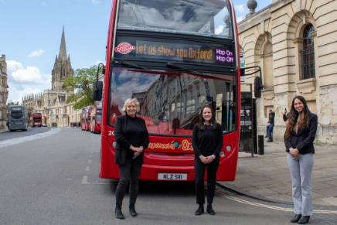
Embracing Diversity:
All-Female Tourism Management Team
We have recently created a revamped tourism management team at Oxford Bus Company and City Sightseeing Oxford to help drive the visitor economy.
The trio of Jane Marshall, Clarisse Garcia and Val Tachy form the all-female team created to ensure visitors to Oxford receive a world class welcome. The focus will be on developing partnerships with key visitor attractions, marketing what Oxford has to offer and delivering a first-class customer service. The tourism triumvirate was created as a part of a commercial restructure at both companies focused on ensuring top class delivery of tourism related services in the City.

Slide 22

Embracing Diversity: Oxford Pride 2021
Once again this year, we are proud to sponsor the Oxford Pride 2021 event. Sadly the event will be taking place digitally this year, so we won’t get to bring our “pride bus” out for the parade through the city centre, but we’ll be providing our support for this important cause nevertheless.

Slide 23
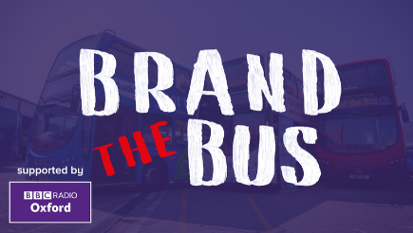
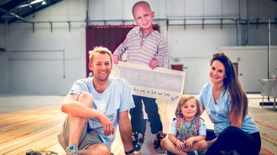
Social Responsibility: ‘Brand the Bus!’
The 2021 edition of our popular ‘Brand the Bus!’ competition is now live.
The winner of this competition gets the branding, logo and messages for their favourite good cause or charity painted all over an Oxford Bus Company bus, which will then be seen by residents and visitors of Oxford. It's a great way for a charity or other good cause to get their message out there (for free!).
We’re now producing the liveries for our 2020/2021 competition winners (Blue Skye Thinking), and runner up (Abingdon RDA), and so keep an eye on those newly branded buses landing in the City over the coming weeks!
We recently received an incredibly positive comment from Home-Start Oxfordshire, winners of the 2019/2020 competition:
“As I’m sure you’re aware, lockdown has been tough on young families. With Health Visitors redeployed, many baby groups cancelled and other parent/infant services reduced it has been more difficult for families to reach us through the normal channels of referral. The bus has been important because it has raised awareness of our service amongst struggling families who might otherwise not have found us. Self referrals are up and we think the bus may have something to do with that. The pandemic has meant that Brand the Bus has been more important than we could ever have predicted. So, can I take this opportunity to thank you and Oxford Bus Company again. Your support has really made a difference over the last difficult year.” Zena Forster, Fundraiser at Home-Start Oxford

Slide 24

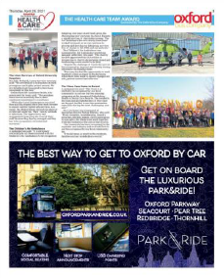
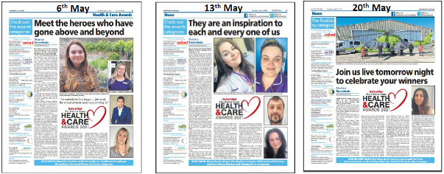
Social Responsibility:
Oxfordshire Health & Social Care Awards 2021
Oxford Bus Company recently sponsored the Heath Care Team Award at the Oxfordshire Health & Social Care Awards 2021, recognizing the talent and dedication of those heroes who work in the industry, particularly in this incredibly testing year.
We were delighted to give the award to the Linen Services Team at Oxford University Hospitals.

Slide 25
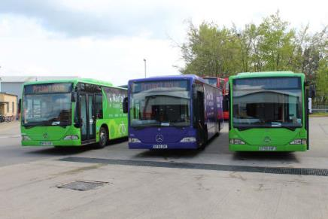
Social Responsibility:
Mobile COVID-19 Testing Buses
At Oxford Bus Company, we’re helping other areas tackle the COVID-19 pandemic across the country via specially converted buses, containing mobile clinical bays.
Four of our converted buses have been deployed to support communities in Norfolk. The service is part of Project MOVE, a scheme created to support the NHS and local authorities by giving vaccines and tests via converted buses. It was made possible via a partnership with design company 40two.
We are currently working on a similar project for Oxfordshire, and we hope to get this over the line with partners soon.
We welcome discussions regarding other similar projects and anyone interested can get in touch with us via email: info@oxfordbus.co.uk.

Slide 26


Working as a Team: Pulse Surveys
We want to ensure that our colleagues feel a part of Oxford Bus Group and that their voice is heard.
To capture their thoughts about working at the Company, we used to do what some felt to be ‘long and cumbersome’ employee surveys once a year. While these helped us to see areas where we could improve, it meant that any changes we made could seem slow. It was also more difficult for us to create action plans as the surveys only capture how our colleagues feel on one day of the year.
That’s why we recently launched our new seasonal quick 'pulse‘ surveys, that occur four times a year. This means colleagues can give us feedback much more regularly and it also helps us identify where and how we can improve. The plan is that these surveys will happen once every season - spring, summer, autumn and winter, and should only take between five and ten minutes to complete.
All colleagues from Oxford Bus Company, Thames Travel, Carousel Buses and City Sightseeing Oxford have the opportunity to participate in these surveys, and we were really pleased to see some great results in the first set of surveys, carried out in March – with a colleague engagement score of 80%!
Of course, there are always areas where we can get better and for this reason, results and actions from our surveys will be communicated to colleagues via short videos (see next slide) and printed documents.
The next pulse survey is coming on 16th June 2021.

Slide 27
Working as a Team: Pulse Surveys
Oxford Bus Company
Results and Actions Video:
Thames Travel
Results and Actions Video:
Carousel Buses
Results and Actions Video:
City Sightseeing Oxford
Results and Actions Video:

Slide 28

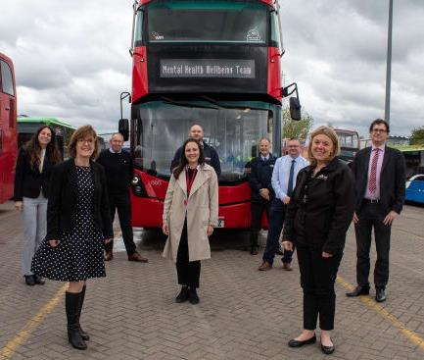
Working as a Team:
Mental Health Wellbeing Team
We have introduced a ‘wellbeing team’ to provide mental health support to colleagues. It was launched in early May and announced during the UK’s Mental Health Awareness Week.
A group of 11 volunteer wellbeing support champions have received specialist mental health training to help them spot triggers, reassure colleagues and source further support where required. The scheme has already successfully provided support to several colleagues, and we plan to train up further members of the wellbeing team in the near future.

Slide 29

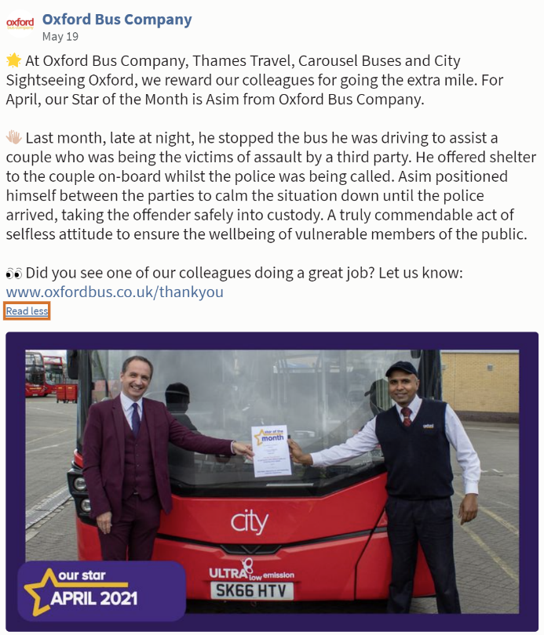
Working as a Team: Stars of the Month
In our recent Stakeholder Survey, you told us that we needed to do more to celebrate the success of our frontline colleagues. In response to this we have made some changes to our “Star of the Month” scheme.
In addition to “Stars of the Month” having their photos published in our bi-weekly internal newsletter, displayed within the Cowley House depot, and invited to the prestigious “Really Amazing Awards”, monthly winners are now starting to appear on our social media channels on a regular basis.
This further supports our promotion of the way other customers can provide us with feedback if they see our colleagues going the extra mile or doing an exceptional job.
Any feedback for a colleague doing a great job can be submitted via an online form: www.oxfordbus.co.uk/thankyou
We also have some further exciting changes coming to our colleague recognition and reward schemes, and we’ll share details of this with you soon!

Slide 30
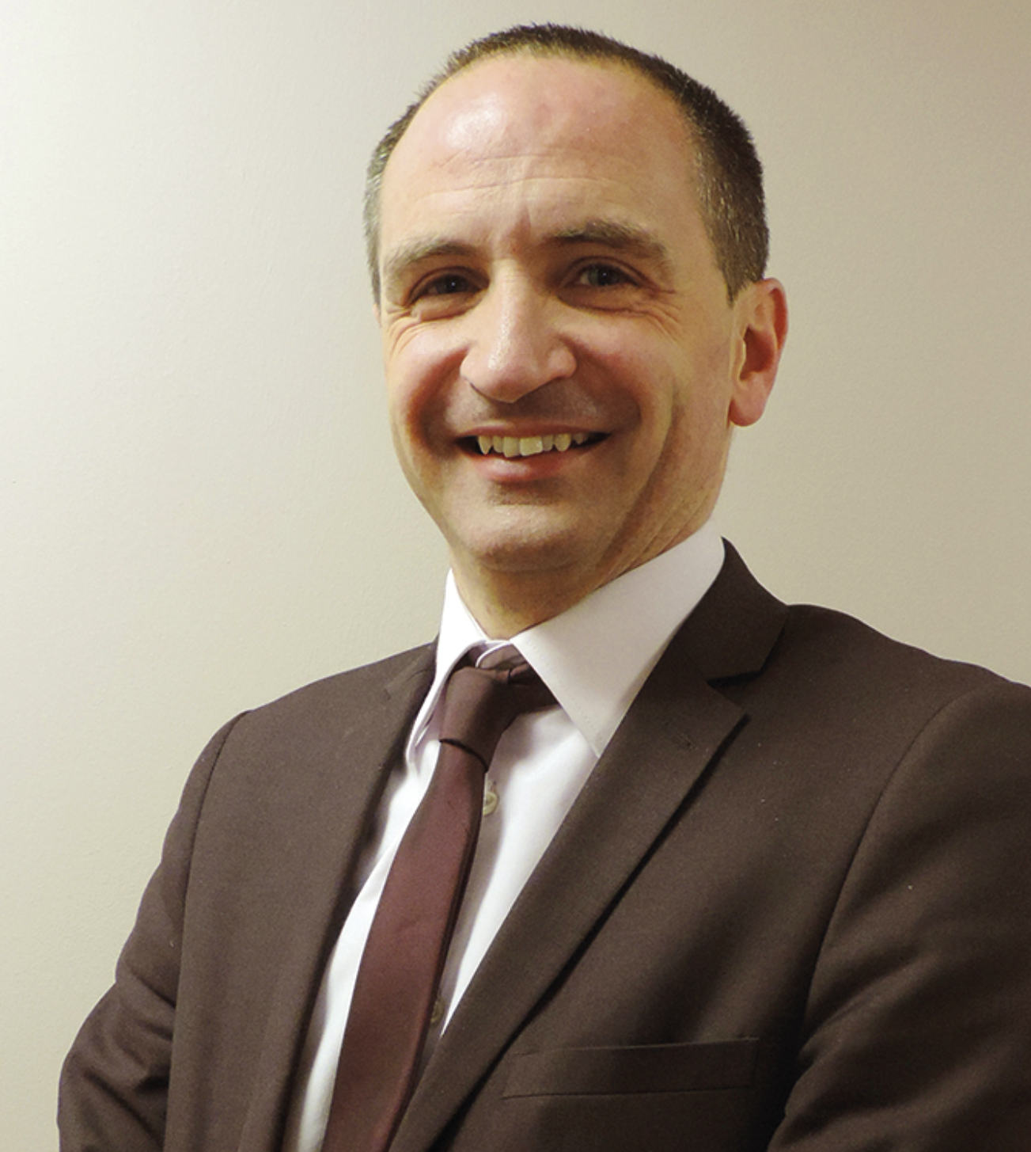
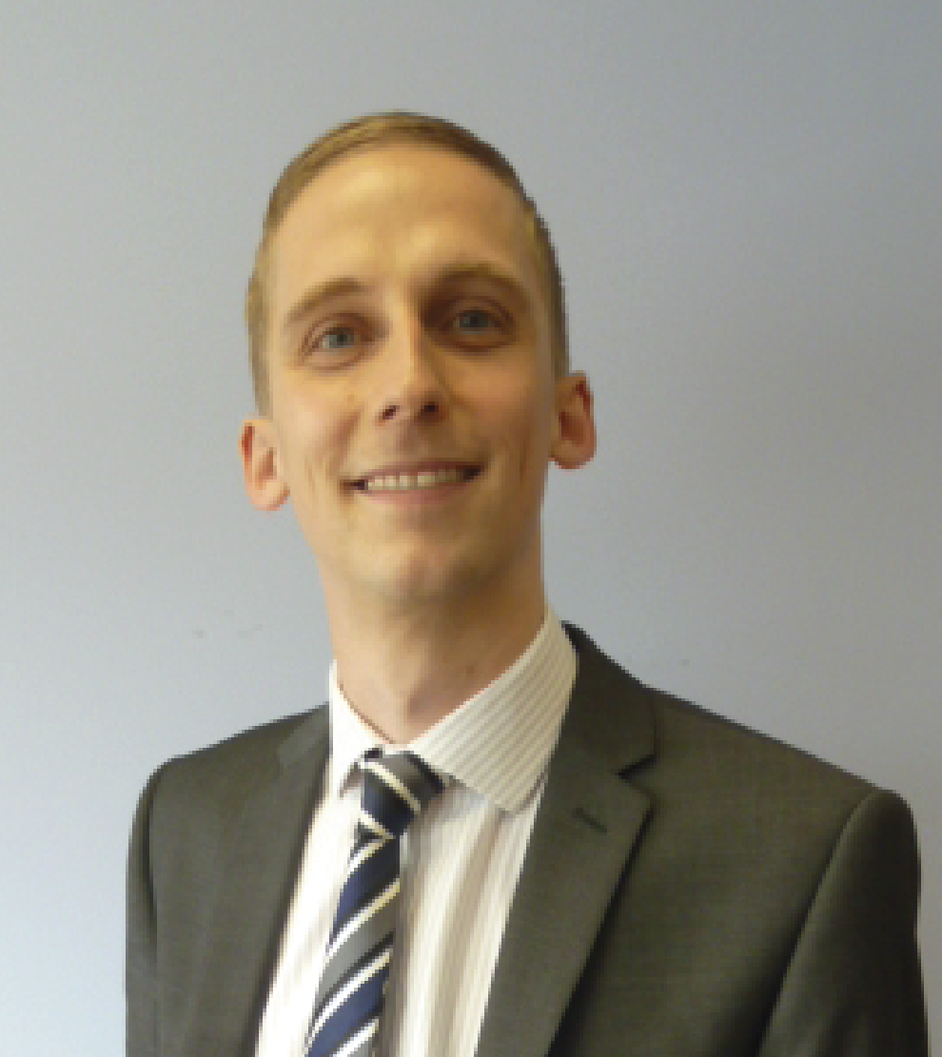
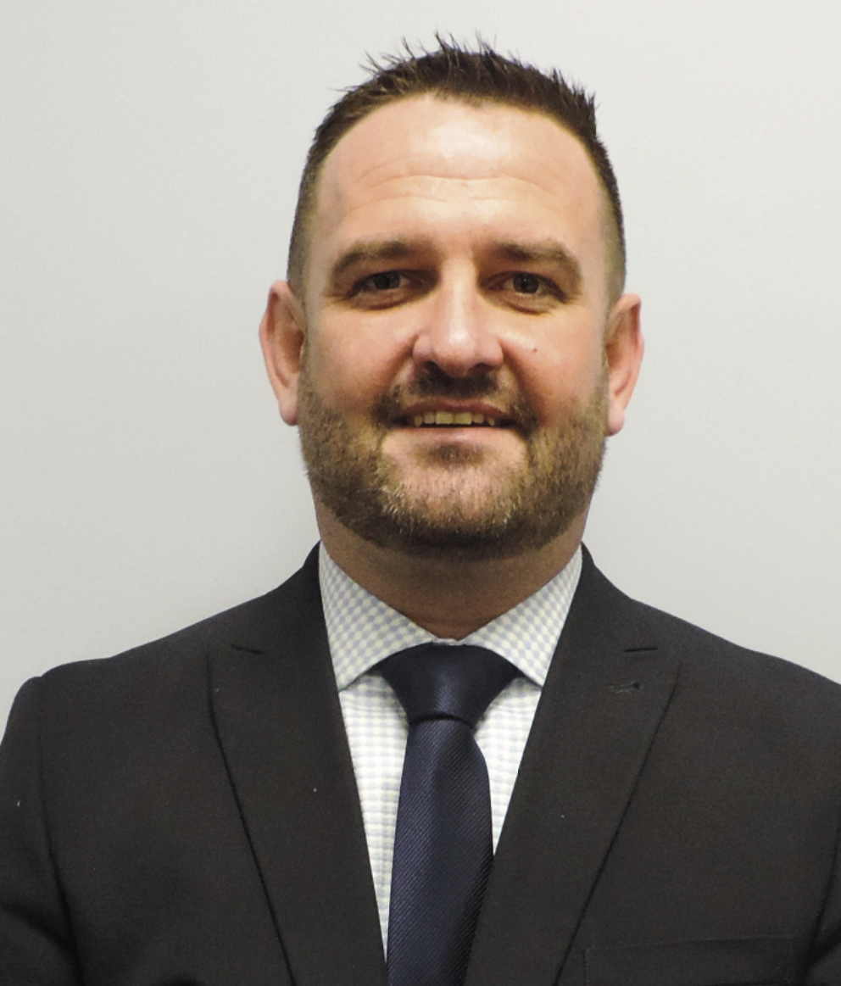
Questions: Contact Our Directors
Phil Southall
Managing Director
Office: 01865 785402
Mob: 07976 396311
Email: phil.southall@oxfordbus.co.uk
Luke Marion
Finance & Commercial Director
Office: 01865 785381
Mob: 07971 074546
Email: luke.marion@oxfordbus.co.uk
Paul Hennigan
Service Delivery Director
Office: 01865785426
Mob: 07971 423061
Email: paul.hennigan@oxfordbus.co.uk

Slide 31
Thank you!
Thank you for all your support during the Pandemic. We’re always open to listen to your ideas and feedback.
If you feel you have something you’d like to share with us, please email us at info@oxfordbus.co.uk.
We’re looking forward to hearing from you.

